Slide 1
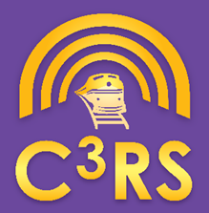
Metra C³RS Peer Review Team (PRT) Newsletter
2021 Year in Review
Issued: March 2022
Notes:
JENNY: introduce Metra’s program, explain the 3 PRTs. Transportation IMOU signed Spring 2015. Mechanical & Engineering IMOU signed Spring 2016.

Slide 2
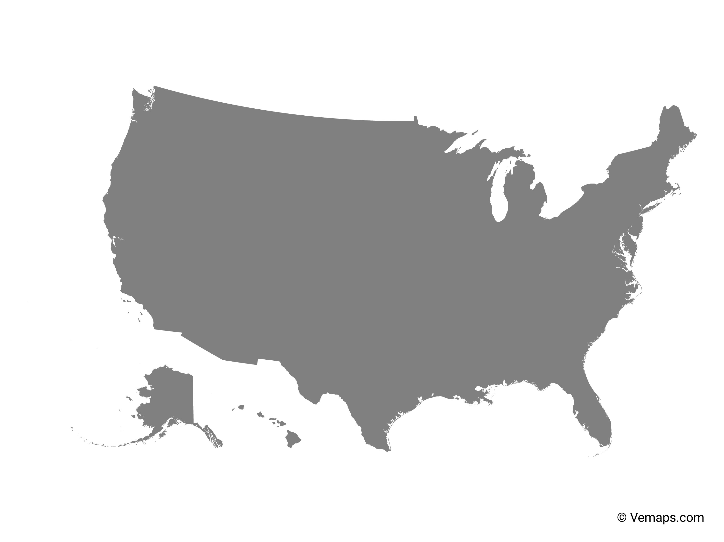
Metra C³RS Peer Review Team (PRT)
C³RS at a Glance - Nationwide
10-year program history
Currently over 20 participating railroads (mostly passenger carriers; some Class II/IIIs)
Over 24,000 reports to date
Notes:
JENNY: this was a presentation shared with management. We find there’s a continual need to educate about the program as management turns over. Thanks to the FRA for coming to Metra last summer and helping us train management and speak with workers in the field.

Slide 3
Metra C³RS Peer Review Team (PRT)
Nationally, about 3000 cases received in 2021. Metra has received 279 cases in 2021. Metra accounts for nearly 10% of all nationwide cases, despite being 1 of over 20 participating railroads. We also see a greater share of Mechanical & Engineering cases compared to other participants.
Notes:
JENNY: something the PRTs review is case breakdown by discipline. We found it noteworthy that while the vast majority of cases are still from Transportation employees, Metra has a greater share of Mechanical & Engineering cases compared to the nationwide distribution. The Transportation PRT also does a lot of case referral to the other PRTs, such as when an Engineer reports a miscommunication with roadway workers or carmen.

Slide 4
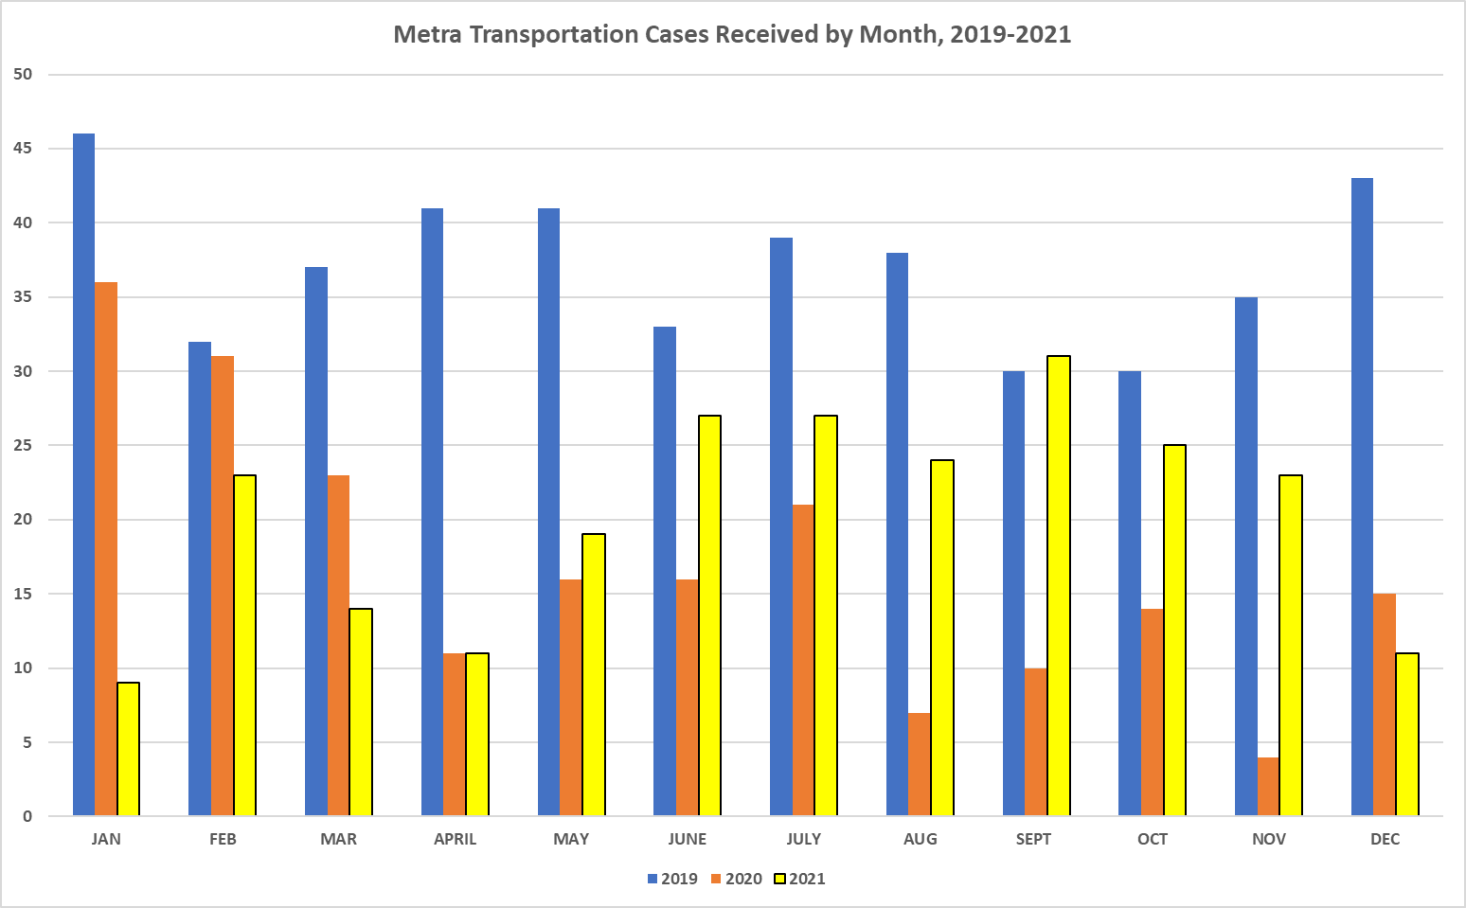
In 2019, Metra Transportation employees were submitting 30-45 cases per month. With the onset of the COVID-19 pandemic, the case rate dropped dramatically.
We started seeing more cases in Summer 2021, but remain below historic levels.
Notes:
JENNY: we examined case submittal by month and year for a 3-year snapshot. The blue bars represent 2019, when we were averaging over 1 case per day coming in from Transportation employees. Orange bars represent 2020, and as you can see by the graphic in March 2020 when COVID hit, case numbers dropped dramatically for the rest of 2020. Our ridership dropped by 90%, and we cut train service in half. While no employees were laid off, many Transportation employees spent a good chunk of 2020 on the extra board. Then the yellow bars represent 2021, where you can see the case numbers start creeping back up in the summer and fall.

Slide 5
Metra C³RS Peer Review Team (PRT) - Transportation
Metra C³RS at a Glance - Transportation
Over 2,000 reports since inception
244 reports received so far in 2021*
Amounts to a new report every 1-2 days
27 cases (11%) were deemed not a case due to either not being a close call or lack of sufficient info to work
Known vs. Unknown events
2019: 16 cases (4%) were known events
2020: 19 cases (9%) were known events
2021 so far: 21 cases (9%) known events
8 (38%) of known cases not covered
*still receiving & reviewing cases from late 2021
Notes:
BRIAN: here are some stats for the Transportation PRT. As mentioned we historically get 1-to-2 new cases per day. A small slice – about 10% over the years – were deemed not a case due to either lack of information or not relevant to the program.
It is important to highlight that fewer than 10% of Transportation cases are known to the carrier. This shows that people are using the program for the right reasons, and that we are learning a lot that we otherwise wouldn’t hear about.
Finally, another thing to highlight is that last year, over 1/3rd of the known events were not covered. That meant that either it was an FRA reportable event, a real-time observation by management, or the employee was not forthcoming about what happened.

Slide 6
“Other” cases explained in subsequent slide…
Notes:
BRIAN: here is an example of the type of data we collect. For Transportation, Engineers lead the way in submitting reports.
Something to highlight here is the growth in Dispatcher-submitted cases last year. We attribute that to complications associated with PTC, as well as a batch of new hires and the loss of a lot of institutional knowledge.

Slide 7
In 2021, Metra Electric saw more reports than in prior years: both in absolute terms and relative to other lines / districts.
Service reductions may have contributed to the decline in reports on lines such as the Heritage & SWS.
Notes:
BRIAN: another way we analyze C3RS data and share it within Metra is by looking at where reports are coming in by line. If one line is “overrepresented” in terms of how many cases are submitted relative to how busy the line is, that might be an indication that better training, coaching, and mentoring is warranted.

Slide 8
Metra C³RS Peer Review Team (PRT) - Transportation
Top Trends from the “Everything Else” Bucket, 2021
AWDM issues with Dispatchers, PTC, Engineers
Door/platform issues - Open while moving, open off-platform
3. Dispatching issues -Blocking errors, lining routes, dropping signals 4. PTC general issues -Glitches, delays, enforcements, distraction
Since program inception at Metra, the share of Headlight & Speeding cases as percent of total has declined. Speeding in particular declined in 2021, likely due to PTC implementation.
Notes:
BRIAN: In the initial years of the program at Metra, we grouped cases by (1) Speeding (2) Headlight and (3) Everything Else. As the program matured, and as speeding cases went down due to PTC, we’ve been getting more granular with the categories.
Last year, we saw issues with Dispatchers working to get gate malfunctions/temporary speed restrictions out to trains. PTC requires our Dispatchers to manually push any alerts out to each train, including to the same crew after the train flips and gets a new train ID.
We also saw a cluster of cases from Conductors regarding doors being opened off-platform.
Now I will hand it over to Toby to discuss the Engineering PRT….

Slide 9
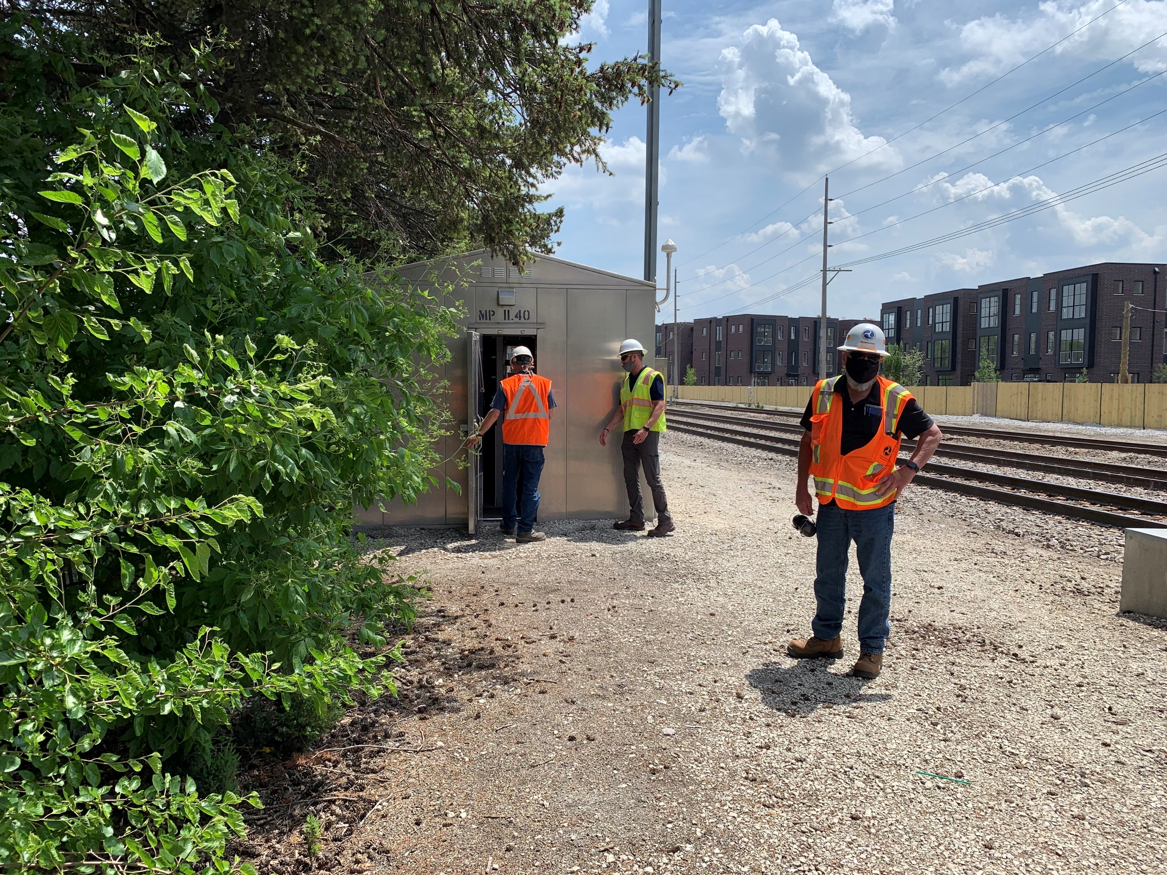
Metra C³RS Peer Review Team (PRT) - Engineering
Metra C³RS at a Glance - Engineering
Cases
21 cases submitted by Engineering employees in 2021, +20 cases referred from Transportation PRT
Corrective Actions
Identified that employees lacked Employee Train Schedules; worked with Service Planning & Engineering to get the schedules re-posted on Employee Portal & distributed to supervisors
Worked with FRA & Engineering management to have Signal employees properly equipped & retrained on jumping out grade crossings
Notes:
TOBY: the Engineering PRT gets about 2 new cases per month, plus an additional 1 or 2 per month referred from Transportation. Many of our cases relate to communication issues between roadway workers and Dispatch and/or train crews. Signal Maintenance is the craft that submits the most cases among Engineering employees, followed by Track Maintenance.
A corrective action we completed was getting Employee Train Schedules re-issued to the field. During COVID the schedule was changing frequently, and management stopped issuing paper schedules to workers and posting current versions on the intranet. The PRT identified this issue and worked with management to resolve it.
Last year two of our biggest known events were grade crossing activation failures. PRT members provided feedback to management and to FRA regarding how Signal employees can be better trained and equipped to properly jump out crossings.
Now I’ll turn it over to Nicolle to discuss the Mechanical PRT….

Slide 10
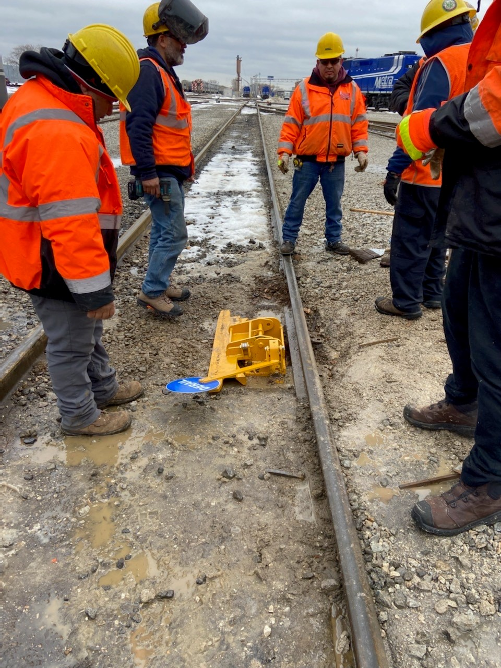
Metra C³RS Peer Review Team (PRT) - Mechanical
Metra C³RS at a Glance - Mechanical
15 cases submitted by Mechanical employees in 2021, +6 cases referred from Transportation PRT
Corrective Actions
Initiated pilot project testing new models of derails
Issued a “Hot Sheet” on forklift & other equipment safe operation / defensive driving
Notes:
NICOLLE: the Mechanical PRT gets about 1 new case per month, plus about 1 case referred from Transportation every couple months. A greater share of Mechanical cases are known to Metra, partly because we work in a more contained setting alongside supervisors and managers.
A key issue in the past year or so has been with portable derails. The model Metra primarily uses involves 2 separate locking mechanisms: 1 for the blue flag, 1 for the derail itself. We had several instances where the flag was downed and the derail left in the derailing position, which contributed to minor yard derailments. The PRT is working with management on a pilot program to test a new model of derail – shown in this photo – where the blue flag and derail are attached to the same mechanism.
Another priority topic for Mechanical employees was equipment operation in the shops and yards. After a couple of C3RS cases and known incidents involving rubber tire equipment, the PRT issued a “Hot Sheet” to all Mechanical employees reminding of defensive driving and safe equipment operating rules.
Now I’ll pass it back to Jenny to wrap things up…

Slide 11
Metra C³RS Peer Review Team (PRT) - Transportation
Completed Corrective Actions:
Three-way calls at CCF between field, Dispatch Desk, Power Desk
Resolved with procedures & job aids implemented
Dual Control Switch Refresh
Resolved with material available on traincrew iPads
Derail Analysis
Analysis complete; consensus reached with Mechanical on RID for derail removal
How-To Videos – complete; available on iPads
Double Check Rule
Gap Switches
Notes:
JENNY: here is a run-down of highlighted corrective actions in recent years.

Slide 12
Metra C³RS Peer Review Team (PRT) - Transportation
Completed Corrective Actions:
Signs installed to warn of no overhead power in select MED locations
DOB discrepancy with CP resolved (software patch)
Dispatcher Job Aid created for tracking of Temp. Speed Restrictions/AWDM
Feedback provided to Engineering on communication/flagging concerns with roadway workers; some improvements observed
Corrected communication lapse when it was discovered not all Dispatchers were receiving PTC software update notes
Notes:
JENNY: some additional completed corrective actions.

Slide 13
Metra C³RS Peer Review Team (PRT) - Transportation
In Progress Corrective Actions:
Headlight switch
Pilot project completed with locomotives on RID, CUS
Await installation of pilot unit on MED & fleetwide deployment
Derail removal
Discussions pending with Mechanical on candidates for removal at RID, CUS locations
Red backing on the headlight switch for cab cars
Installation not complete fleetwide; issues arising with wear & tear of backing where installed
Notes:
JENNY: these actions are in progress.

Slide 14
Metra C³RS Peer Review Team (PRT) - Transportation
In Progress Corrective Actions:
Revive issuance of Employee Timetables, ensure availability for RWW
Radio & Emergency Stop-related rule revisions
Working with Rules on proposed edits to Rule 2.10 & 6.23 regarding emergency calls over radio & train inspection/brake testing
Dispatcher/Power Desk training
Providing feedback to CCF & Training on an ongoing basis for new Dispatcher Training and to-be-developed Power Desk Training curricula
Platform markers requested
Some installed in CUS locations; await installation elsewhere
Notes:
JENNY: some more in-progress actions

Slide 15
Metra C³RS Peer Review Team (PRT) - Transportation
New/Proposed Corrective Actions:
PTC configuration changes
Account for hour before and hour after Form B
Mile Post references by ¼ or ½ mile for bulletins
Switch & absolute signal references match the field
Recognize different MAS for light engine moves
SCADA configuration changes
Ability to zoom in on switches
Change mgt. process for updating power SCADA after field changes
Notes:
JENNY: these are some proposed corrective actions

Slide 16
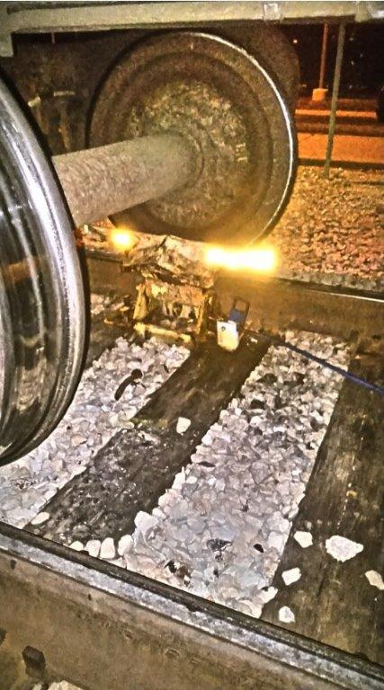
Metra C³RS Peer Review Team (PRT) - Transportation
2021 Known Event Highlight
What Happened?
Mechanical downed the blue flag, but did not remove derail
Mechanical advised train crew “good to go” or similar
Train crew did not double-check the lineup
Derail was dirty/difficult to see
Train ran over derail
What Could Have Worked Better?
Proper derail removal
Mechanical advise train crew “double-check your lineup”
Train crew completes proper double-check
Assumption + Complacency = FAILURE
Notes:
JENNY: when there is a higher profile known event, even if the employees are not covered by C3RS protection, the PRT still thoroughly works the case. We often report back to management with our observations and suggestions, and sometimes share the case narrative with management, in hopes that it can a tool used in employee training and/or safety meetings.

Slide 17
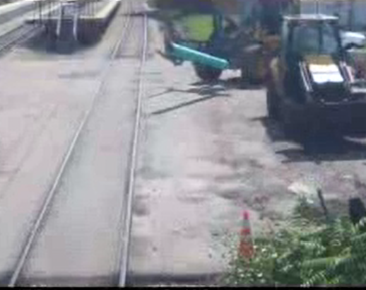
Metra C³RS Peer Review Team (PRT) - Transportation
2021 Known Event Highlight
What Happened?
Form C protection
Method of communication that flagman in vehicle = safe to foul
Flagman took phone call in vehicle
Equipment fouled ROW ahead of a train
Engineer emergency stop to avoid collision
What Could Have Worked Better?
Form B protection
Ensure proper sight lines in work zone configuration
Proper job safety briefing, roadway worker training & communication
Failure to plan is a plan to fail
Notes:
JENNY: this was a critical near miss where a lot went wrong, but fortunately no one was hurt.

Slide 18
Metra C³RS Peer Review Team (PRT) - Transportation
Mission Statement: The PRT will analyze critical close call data through a collaborative effort between management and labor for the purpose of implementing comprehensive safety solutions that will benefit all participating employees in a trustworthy forum that is established without fear of retribution.
To fill out a C3RS report: https://c3rs.arc.nasa.gov/
Thank You
Notes:
JENNY: thank you. Any questions?

